Slide 1

PYTHON FINAL REPORT :
PROJECT TITLE : TO CREATE A NUMBER GUESS GAME THAT GENARATES A RANDOM NUMBER IN BETWEEN FIXED RANGE WITHIN THREE CHANCES
SUBMITTED BY: GNANESWAR REDDY
REGNISTRATION NUMBER:12200658
COURSE:COMPUTER SCIENCE AND ENGINEERING
SUBMITTED TO :DR.RADHIKA NAMBIAR
ROLL NUMBER : 19

Slide 2
ACKNOWLEDGEMENT
No doubt this project is only possible because of my mentor and my Prof. Dr. RADHIKA NAMBIAR mam and We would like to thank her from depth of our heart for giving us knowledge of Python and for also giving me so many advices and various more inputs in this project. And also We want to say thanks to my all friends and family who gave me so many wonderful feedbacks in this project

Slide 3
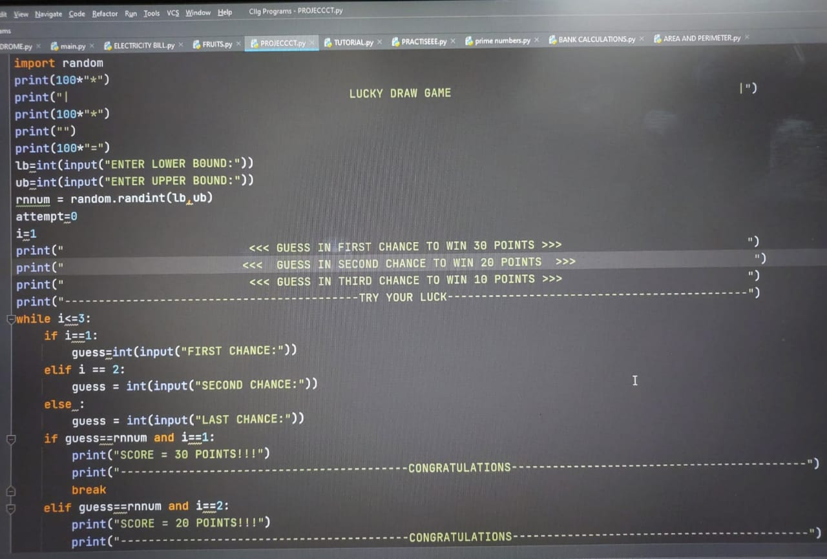
DESIGN-SOURCE CODE This is code screenshot and code will be in next page

Slide 4
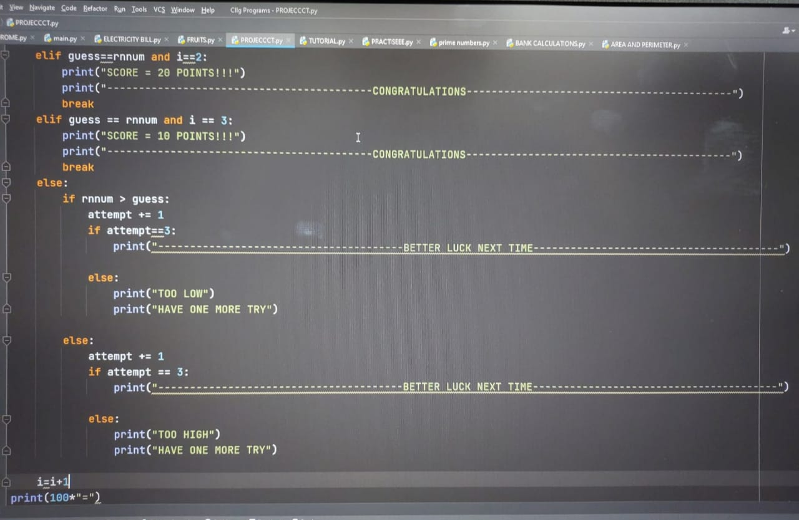

Slide 5
SOURCE CODE:
import random print(100*"*") print("| LUCK DRAW GAME |") print(100*"=") lb=int(input("ENTER LOWER BOUND:")) ub=int(input("ENTER UPPER BOUND:")) rnnum = random.randint(lb,ub) attempt=0 i=1 print(" <<< GUESS IN FIRST CHANCE TO WIN 30 POINT>>> ") print(" <<< GUESS IN FIRST CHANCE TO WIN 20 POINT>>> ") print(" <<< GUESS IN FIRST CHANCE TO WIN 10 POINT>>> ") print("-------------------------------------------TRY YOUR LUCK--------------------------------") while i<=3: if i==1: guess=int(input("FIRST CHANCE")) elif i == 2: guess = int(input("SECOND CHANCE:")) else : guess = int(input("LAST CHANCE:")) if guess==rnnum and i==1:

Slide 6
print("SCORE = 30 POINTS!!!") print("-----------------------------------------CONGRATULATIONS--------------------------------") break elif guess==rnnum and i==2: print("SCORE = 20 POINTS!!!") print("-------------------------------------------CONGRATULATIONS-------------------------------") break elif guess == rnnum and i == 3: print("SCORE = 10 POINTS!!!") print("--------------------------------------------CONGRATULATIONS-------------------------------") break else: if rnnum > guess: attempt += 1 if attempt==3: print("-----------------------------------------BETTER LUCK NEXT TIME---------------------------") else: print("TOO LOW") print("HAVE ONE MORE TRY") else: attempt += 1 if attempt == 3: print("-----------------------------------------BETTER LUCK NEXT TIME----------------------------") else: print("TO HIGH") print("HAVE ONE MORE TRY") i=i+1 print(100*"=")

Slide 7
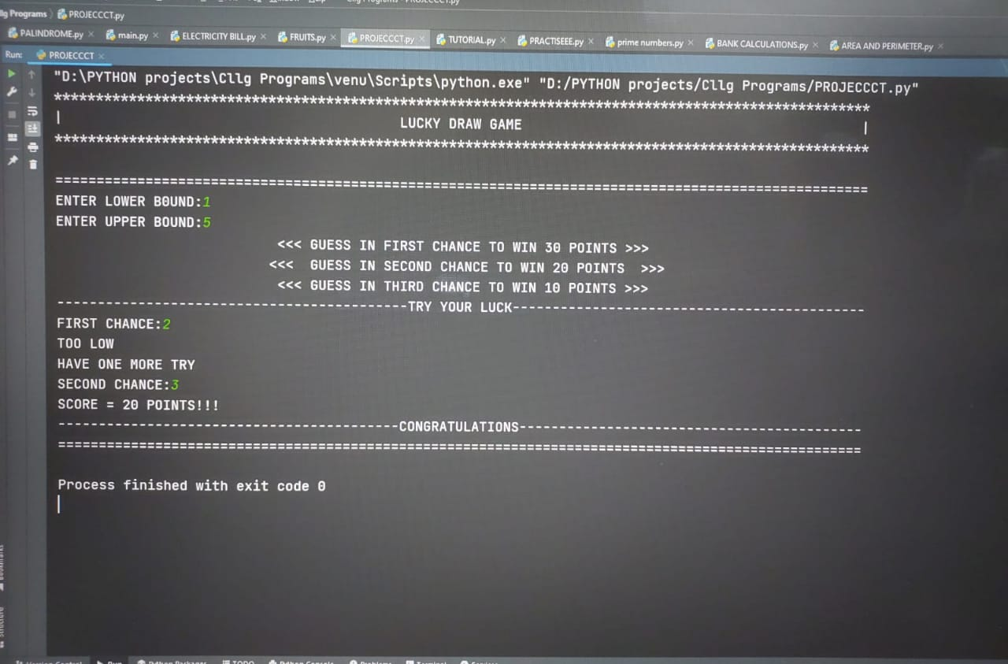
RESULT PAGE

Slide 8
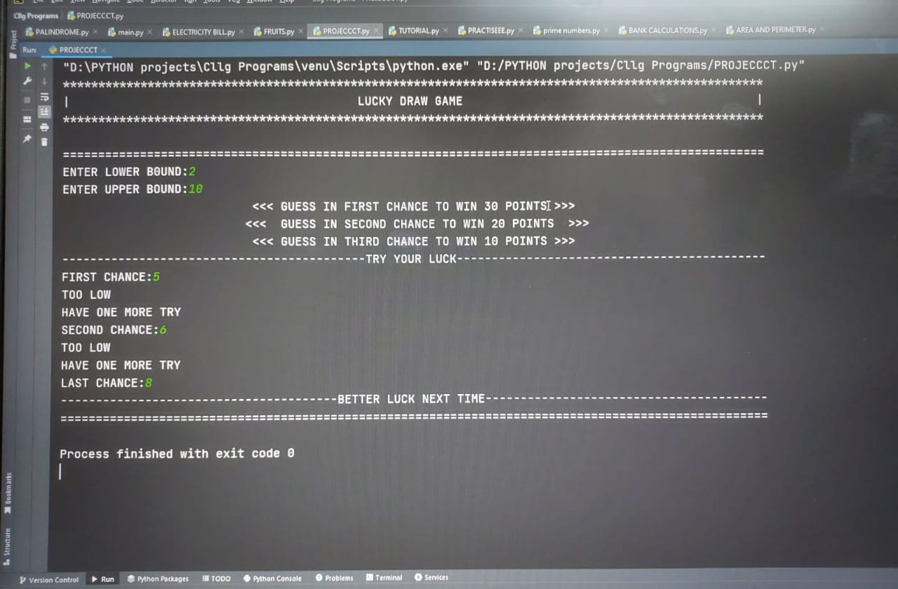

Slide 9
CONCLUSION
We hope and we wish that this document will help you to understand about our minimalist but attractive project as I had tried something
different from usual. We had used Python for logical

